Slide 1

UNIT 2
Software Project Management: Software project management complexities, Responsibilities of a software project manager, Metrics for project size estimation, Project estimation techniques, Empirical Estimation techniques, COCOMO, Halstead’s software science, risk management.
Requirements Analysis And Specification: Requirements gathering and analysis, Software Requirements Specification (SRS), Formal system specification, Axiomatic specification, Algebraic specification, Executable specification and 4GL

Slide 2
Software project management complexities
we first investigate why management of software projects is much more complex than managing many other types of projects
Invisibility: Software remains invisible, until its development is complete and it is operational. Anything that is invisible, is difficult to manage and control.

Slide 3
Software project management complexities
Complexity: Even a moderate sized software has millions of parts (functions) that interact with each other in many ways—data coupling, serial and concurrent runs, state transitions, control dependency, file sharing, etc.
Changeability: Because the software part of any system is easier to change as compared to the hardware part, the software part is the one that gets most frequently changed.
Uniqueness: Every software project is usually associated with many unique features or situations. This makes every project much different from the others.

Slide 4
Software project management complexities
Team-oriented and intellect-intensive work: Software development projects are akin to research projects in the sense that they both involve team-oriented, intellect-intensive work.
Exactness of the solution: the parameters of a function call in a program are required to be in complete conformity with the function definition.

Slide 5
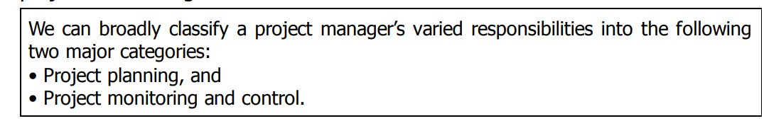
Responsibilities of a software project manager
1. Job Responsibilities for Managing Software Projects

Slide 6
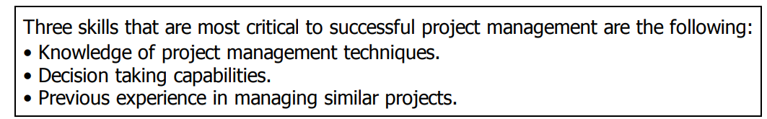
Responsibilities of a software project manager
2. Skills Necessary for Managing Software Projects

Slide 7
METRICS FOR PROJECT SIZE ESTIMATION
Accurate estimation of project size is central to satisfactory estimation of all other project parameters such as effort, completion time, and total project cost.
Currently, two metrics are popularly being used to measure size—lines of code (LOC) and function point (FP).

Slide 8
METRICS FOR PROJECT SIZE ESTIMATION
LOC is possibly the simplest among all metrics available to measure project size.
This metric measures the size of a project by counting the number of source instructions in the developed program.
Obviously, while counting the number of source instructions, comment lines, and header lines are ignored.

Slide 9
METRICS FOR PROJECT SIZE ESTIMATION
Shortcomings of the LOC metrics
1. LOC is a measure of coding activity alone. A good problem size measure should consider the total effort needed to carry out various life cycle activities (i.e. specification, design, code, test, etc.) and not just the coding effort.
2. LOC count depends on the choice of specific instructions: LOC gives a numerical value of problem size that can vary widely with coding styles of individual programmers.
3. LOC measure correlates poorly with the quality and efficiency of the code: Larger code size does not necessarily imply better quality of code or higher efficiency.

Slide 10
METRICS FOR PROJECT SIZE ESTIMATION
Shortcomings of the LOC metrics
4. It is very difficult to accurately estimate LOC of the final program from problem specification: As already discussed, at the project initiation time, it is a very difficult task to accurately estimate the number of lines of code (LOC) that the program would have after development.

Slide 11
METRICS FOR PROJECT SIZE ESTIMATION
Function Point (FP) Metric
Function point metric was proposed by Albrecht in 1983. This metric overcomes many of the shortcomings of the LOC metric.
The function point metric is based on the idea that a software product
supporting many features would certainly be of larger size than a product with less number of features.

Slide 12
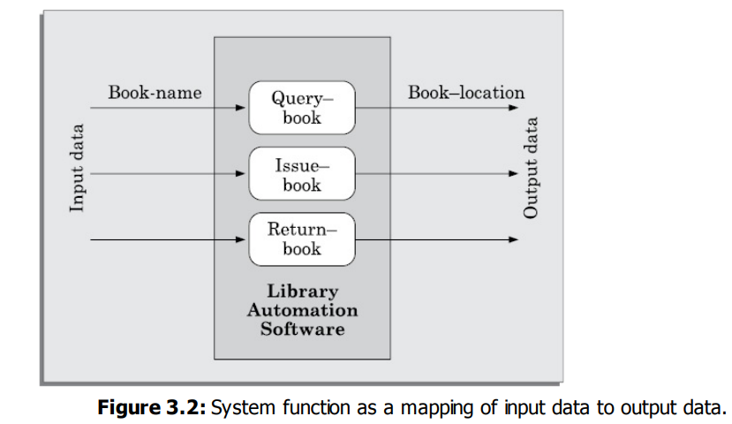
METRICS FOR PROJECT SIZE ESTIMATION
Function Point (FP) Metric

Slide 13
METRICS FOR PROJECT SIZE ESTIMATION
Function Point (FP) Metric Computation
Step 1: UFP computation
The unadjusted function points (UFP) is computed as the weighted sum of five characteristics of a product as shown in the following expression.
UFP = (Number of inputs)*4 + (Number of outputs)*5 + (Number of inquiries)*4 + (Number of files)*10 + (Number of interfaces)*10

Slide 14
Function Point (FP) Metric Computation
UFP = (Number of inputs)*4 + (Number of outputs)*5 + (Number of inquiries)*4 + (Number of files)*10 + (Number of interfaces)*10
Number of inputs: Each data item input by the user is counted.
Number of outputs: The outputs considered include reports printed, screen outputs, error messages produced, etc.
Number of inquiries: An inquiry is a user command (without any data input) and only requires some actions to be performed by the system.(print account balance, print all student grades, display rank holders’ names)
Number of files: The files referred to here are logical files. A logical file represents a group of logically related data.
Number of interfaces: Here the interfaces denote the different mechanisms that are used to exchange information with other systems.

Slide 15
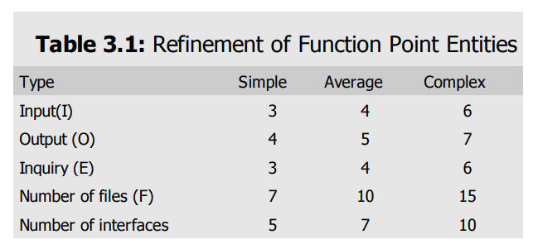
Function Point (FP) Metric Computation
Step 2: Refine parameters
UFP computed at the end of step 1 is a gross indicator of the problem size. This UFP needs to be refined. (unadjusted function points)

Slide 16
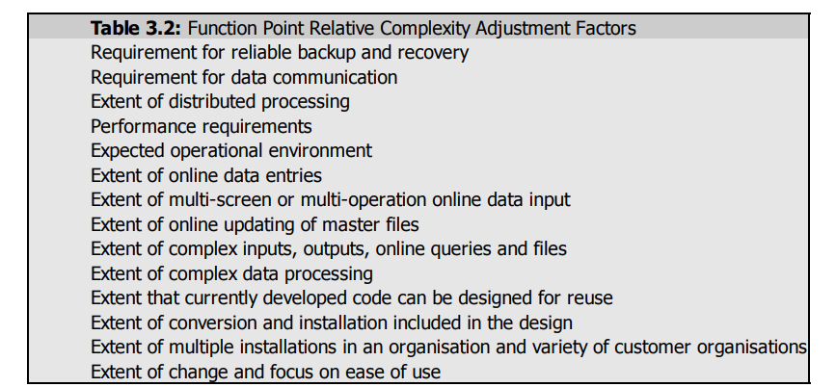
Function Point (FP) Metric Computation
Step 3: Refine UFP based on complexity of the overall project
The resulting numbers are summed, yielding the total degree of influence (DI)

Slide 17
Function Point (FP) Metric Computation
Step 3: Refine UFP based on complexity of the overall project
Technical complexity factor (TCF) = (0.65+0.01*DI)
FP=UFP*TCF
Functional point = unadjusted function points * Technical complexity factor

Slide 18
Risk Management
Every project is susceptible to a large number of risks.
Risk Identification
A project can be subject to a large variety of risks.
In order to be able to systematically identify the important risks which might affect a project, it is necessary to categorize risks into different classes.
(i) Project risks: Project risks concern various forms of budgetary, schedule, personnel, resource, and customer-related problems.

Slide 19
Risk Management
(ii) Technical risks: Technical risks concern potential design, implementation, interfacing, testing, and maintenance problems.
(iii) Business risks: This type of risks includes the risk of building an excellent product that no one wants, losing budgetary commitments, etc
2. Risk Assessment
For risk assessment, first each risk should be rated in two ways: The likelihood of a risk becoming real (r). The consequence of the problems associated with that risk (s)
p=r*s
where, p is the priority with which the risk must be handled, r is the probability of the risk becoming real, and s is the severity of damage caused due to the risk becoming real

Slide 20
Risk Management
3. Risk Mitigation
After all the identified risks of a project have been assessed, plans are made to contain the most damaging and the most likely risks first.
There are three main strategies for risk containment:
Avoid the risk: Risks can be avoided in several ways
Process-related risk: These risks arise due to aggressive work schedule, budget, and resource utilization.
Product-related risks: These risks arise due to commitment to challenging product features (e.g. response time of one second, etc.), quality, reliability etc.
Technology-related risks: These risks arise due to commitment to use certain technology (e.g., satellite communication).

Slide 21
Risk Management
3. Risk Mitigation
(ii) Transfer the risk: This strategy involves getting the risky components developed by a third party, buying insurance cover, etc.
(iii) Risk reduction: This involves planning ways to contain the damage due to a risk.
The most important risk reduction techniques for technical risks is to build a prototype that tries out the technology that you are trying to use

Slide 22
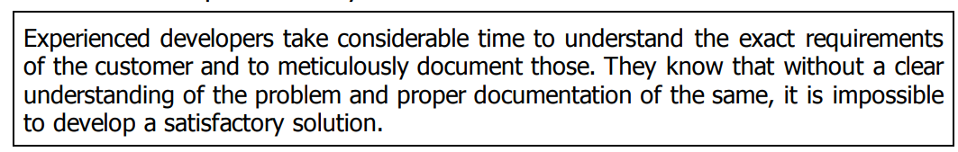
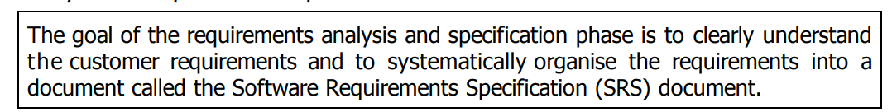
REQUIREMENTS ANALYSIS AND SPECIFICATION
An overview of requirements analysis and specification phase

Slide 23
REQUIREMENTS ANALYSIS AND SPECIFICATION
What are the main activities carried out during requirements analysis and specification phase?
Requirements analysis and specification phase mainly involves carrying out the following two important activities:
• Requirements gathering and analysis
• Requirements specification

Slide 24
REQUIREMENTS ANALYSIS AND SPECIFICATION
REQUIREMENTS GATHERING AND ANALYSIS
The complete set of requirements are almost never available in the form of a single document from the customer.
Therefore, the requirements have to be gathered by the analyst from several sources in bits and pieces. These gathered requirements need to be analyzed.

Slide 25
REQUIREMENTS ANALYSIS AND SPECIFICATION
Requirements Gathering
Requirements gathering is also popularly known as requirements elicitation.
The primary objective of the requirement's gathering task is to collect the requirements from the stakeholders.

Slide 26
REQUIREMENTS ANALYSIS AND SPECIFICATION
In the following, we briefly discuss the important ways in which an experienced analyst gathers requirements:
Studying existing documentation
Interview
Task-analysis (Black-box view)
Scenario based analysis
Form analysis

Slide 27
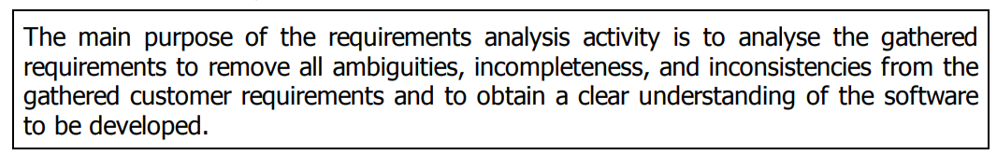
REQUIREMENTS ANALYSIS AND SPECIFICATION
Requirements Analysis
After requirements gathering is complete, the analyst analyses the gathered requirements to form a clear understanding of the exact customer requirements and to weed out any problems in the gathered requirements.

Slide 28
REQUIREMENTS ANALYSIS AND SPECIFICATION
Requirements Analysis
What is the problem?
Why is it important to solve the problem?
What exactly are the data input to the system and what exactly are the data output by the system?
What are the possible procedures that need to be followed to solve the problem?
What are the likely complexities that might arise while solving the problem?
If there are external software or hardware with which the developed software has to interface, then what should be the data interchange formats with the external systems?

Slide 29
SOFTWARE REQUIREMENTS SPECIFICATION (SRS)
After the analyst has gathered all the required information regarding the software to be developed, and has removed all incompleteness, inconsistencies, and anomalies from the specification, he starts to systematically organize the requirements in the form of an SRS document.
Among all the documents produced during a software development life cycle, SRS document is probably the most important document and is the toughest to write.

Slide 30
SOFTWARE REQUIREMENTS SPECIFICATION (SRS)
Users of SRS Document
Users, customers, and marketing personnel
Content design developers
Software developers
Test engineers
User documentation writers
Project managers
Maintenance engineers

Slide 31
SOFTWARE REQUIREMENTS SPECIFICATION (SRS)
Uses of SRS Document
Forms an agreement between the customers and the developers
Reduces future reworks
Provides a basis for estimating costs and schedules
Provides a baseline for verification and validation
Facilitates future extensions
Verification – Are we building the product right?
Validation - Are we building the right product?

Slide 32
SOFTWARE REQUIREMENTS SPECIFICATION (SRS)
Characteristics of a Good SRS Document
The skill of writing a good SRS document usually comes from the experience gained from writing SRS documents for many projects.
However, the analyst should be aware of the desirable qualities that every good SRS document should possess.
IEEE Recommended Practice for Software Requirements Specifications describes the content and qualities of a good software requirements specification (SRS).

Slide 33
SOFTWARE REQUIREMENTS SPECIFICATION (SRS)
Characteristics of a Good SRS Document
Concise: The SRS document should be concise and at the same time unambiguous, consistent, and complete.
Implementation-independent: The SRS should be free of design and implementation decisions unless those decisions reflect actual requirements.
This means that the SRS document should specify the externally visible behavior of the system and not discuss the implementation issues.
Traceable: It should be possible to trace a specific requirement to the design elements that implement it and vice versa.

Slide 34
SOFTWARE REQUIREMENTS SPECIFICATION (SRS)
Characteristics of a Good SRS Document
Modifiable: Customers frequently change the requirements during the software development due to a variety of reasons.
Identification of response to undesired events: The SRS document should discuss the system responses to various undesired events and exceptional conditions that may arise.
Verifiable: All requirements of the system as documented in the SRS document should be verifiable.

Slide 35
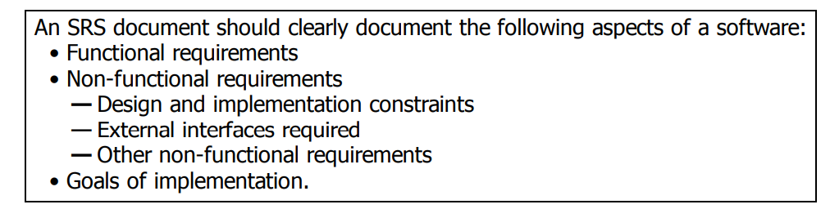
SOFTWARE REQUIREMENTS SPECIFICATION (SRS)

Slide 36
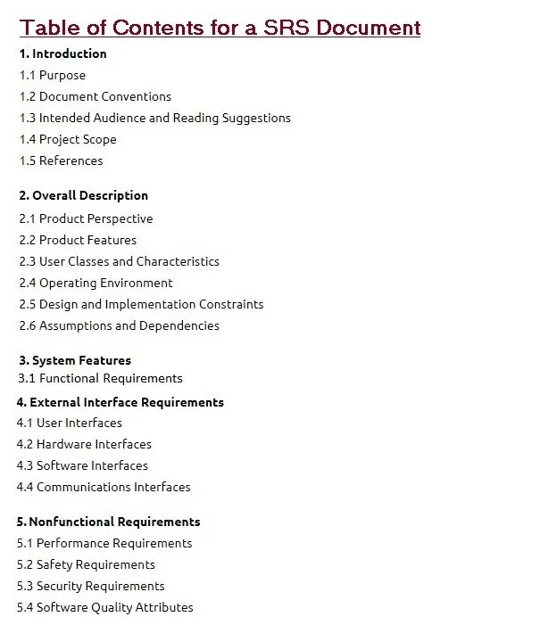
SOFTWARE REQUIREMENTS SPECIFICATION (SRS)

Slide 37
SOFTWARE REQUIREMENTS SPECIFICATION (SRS)
Functional requirements describe the desired end function of a system operating within normal parameters and make the desired product and the end product reaches its potential in order to meet user expectations.
Functional requirements define the specific behavior or functions of a system.
In contrast, non-functional requirements specify how the system performs its tasks, focusing on attributes like performance, security, scalability, and usability.

Slide 38
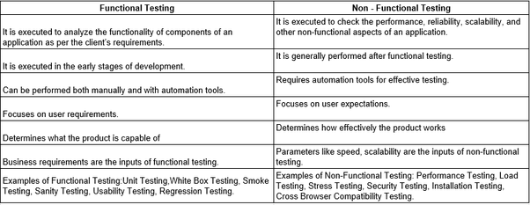
SOFTWARE REQUIREMENTS SPECIFICATION (SRS)

Slide 39
SOFTWARE REQUIREMENTS SPECIFICATION (SRS)

